Slide 1
Introduction to Flowcharting

Slide 2
What is a Flowchart?
START
Display message “How many hours did you work?”
A flowchart is a diagram that depicts the “flow” of a program.
The figure shown here is a flowchart for the pay-calculating program shown in Program 1-1.
Read Hours
Display message “How much do you get paid per hour?”
Read PayRate
Multiply Hours by PayRate. Store result in GrossPay.
Display GrossPay
END

Slide 3
Basic Flowchart Symbols
START
Terminal
Display message “How many hours did you work?”
Terminals
  represented by rounded rectangles
  indicate a starting or ending point
Read Hours
Display message “How much do you get paid per hour?”
Read PayRate
Multiply Hours by PayRate. Store result in GrossPay.
START
Display GrossPay
END
Terminal
END

Slide 4
Basic Flowchart Symbols
START
Display message “How many hours did you work?”
Input/Output Operations
  represented by parallelograms
  indicate an input or output operation
Read Hours
Display message “How much do you get paid per hour?”
Input/Output Operation
Read PayRate
Multiply Hours by PayRate. Store result in GrossPay.
Display message “How many hours did you work?”
Read Hours
Display GrossPay
END

Slide 5
Basic Flowchart Symbols
START
Display message “How many hours did you work?”
Processes
  represented by rectangles
  indicates a process such as a mathematical computation or variable assignment
Read Hours
Display message “How much do you get paid per hour?”
Read PayRate
Multiply Hours by PayRate. Store result in GrossPay.
Multiply Hours by PayRate. Store result in GrossPay.
Process
Display GrossPay
END

Slide 6
Flowchart Structures
Sequence
Decision
Repetition

Slide 7
Sequence Structure
A series of actions are performed in sequence
The pay-calculating example was a sequence flowchart.

Slide 8
Decision Structure
The flowchart segment below shows how a decision structure is expressed in C++ as an if/else statement.
Flowchart
C++ Code
NO
YES
if (x < y)
a = x * 2;
else
a = x + y;
x < y?
Calculate a as x plus y.
Calculate a as x times 2.

Slide 9
Decision Structure
The flowchart segment below shows a decision structure with only one action to perform. It is expressed as an if statement in C++ code.
Flowchart
C++ Code
NO
YES
if (x < y)
a = x * 2;
x < y?
Calculate a as x times 2.

Slide 10
Repetition Structure
The flowchart segment below shows a repetition structure expressed in C++ as a while loop.
Flowchart
C++ Code
while (x < y)
x++;
YES
x < y?
Add 1 to x

Slide 11
Controlling a Repetition Structure
The action performed by a repetition structure must eventually cause the loop to terminate. Otherwise, an infinite loop is created.
In this flowchart segment, x is never changed. Once the loop starts, it will never end.
QUESTION: How can this
flowchart be modified so
it is no longer an infinite
loop?
YES
x < y?
Display x

Slide 12
Controlling a Repetition Structure
ANSWER: By adding an action within the repetition that changes the value of x.
YES
x < y?
Display x
Add 1 to x

Slide 13
Connectors
The “A” connector indicates that the second flowchart segment begins where the first segment ends.
START
A
END
A

Slide 14
Modules
The position of the module symbol indicates the point the module is executed.
A separate flowchart can be constructed for the module.
START
Read Input.
Call calc_pay function.
Display results.
END

Slide 15
Combining Structures
This flowchart segment
shows two decision
structures combined.
NO
YES
x > min?
Display “x is outside the limits.”
NO
YES
x < max?
Display “x is outside the limits.”
Display “x is within limits.”

Slide 16
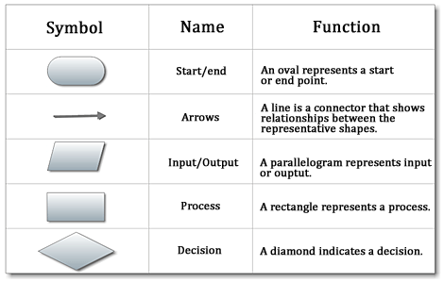

Slide 17
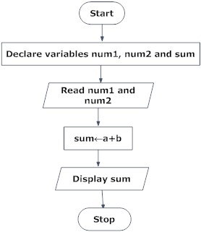

Slide 18
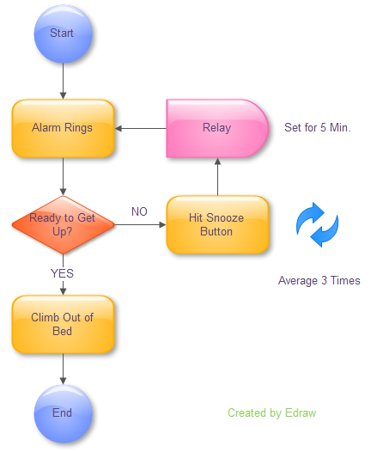


Slide 19
Questions – Lab 6
Create flowcharts for the following operations of the student details module of a library management system:
  Add a student to the student details table
  Modify details of a student from the student details table
  Delete a student from the student details table

